Slide 1

DEPARTMENT OF INFORMATION SCIENCE & ENGINEERING
“WEB-BASED SOLUTION PROVIDER FOR COOPERATES”
Presentation by,
NAME :ANKIT SINGH
USN: 1NH18IS010
Under the Guidance of ,
Guide Name: Ms. K.M BILVIKA
Designation: Professor

Slide 2
:Agenda:
Introduction
Problem Definition
Objectives
Proposed system
System Design
Expected Outcome
Conclusion

Slide 3
Introduction
“WEB-BASED SOLUTION PROVIDER FOR COOPERATES”
is a solution based website for the cooperate named by “CMC, easy to use”, which is entitled to provide the technical support and apt solutions for their Clients associated with their organization.

Slide 4
An amalgamation of Web-pages containing the :
1. Information about the company,
2. Taking queries from the clients through the login pages and providing separate web pages for further interaction.
3.Providing the solution from the unique Id’s to the clients.

Slide 5
Languages
Languages used to develop the Web Application are:-
Front end: Html,Javascript, and CSS
Backend: php and SQL

Slide 6
Problem Definition
A huge chunck of precious time of any firm or organization is wasted when it comes down into handling their clients basic queries over time to time.
Resolving the same type of queries in numerous amount can be really a daunting task .

Slide 7
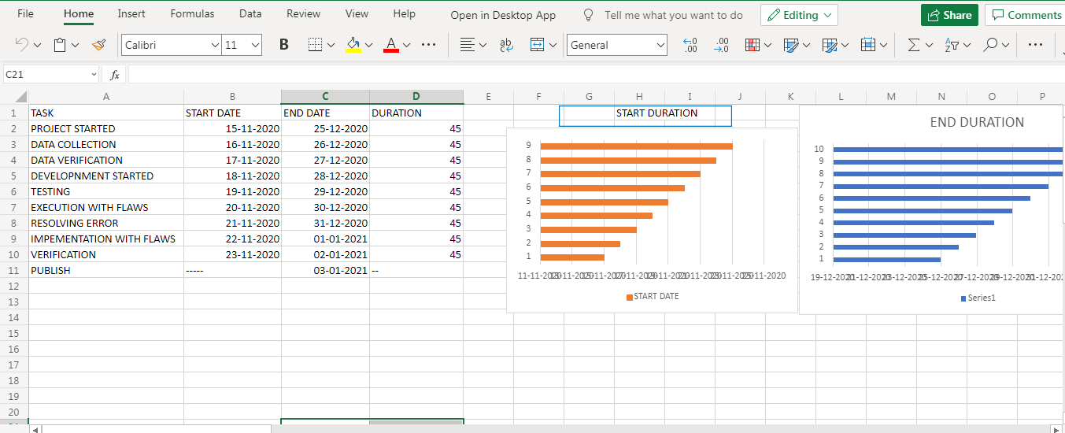
GANTT CHART

Slide 8
Objectives(1 slide)
To provide Easy and comfortable way to tackle with the clients queries repeated with multiple amount of type.
To provide a better experience to the employee and the client.

Slide 9
Architectural Design of the System

Slide 10
Click on the login to techical assestance
logo
Register
Login
HOME
SERVICES
ABOUT

Slide 11
Proposed System-Architectural Design of the System
LOGIN FORM
SUBMIT

Slide 12
SQL SERVER
CLIENT NAME | ID
LOGIN FORM
SUBMIT

Slide 13
Expected Outcome
CLIENT SIDE PAGE
QUERY GENERATED
//QUERY//
SOLUTION PROVIDER
NAME
SOLUTION

Slide 14
Conclusion
In a Nutshell, the above project is taken to work upon a client query with a motive to provide the easy access of the Information, help and to improve the further accestance of the client in a much more effective way.

Slide 15
Thank you

